Slide 1
Project Topic:
Contextual Embeddings (ELMo) for Indian Languages
&
A Novel Semi-Intrinsic Approach to Evaluate Word Embeddings for Robustness
Gaurang Patil – 2023701002
Ishank Kapania – 2023701012
Anshul Sharma – 2023701011

Slide 2
Problem Statement & Introduction
Problems with non-contextual embeddings like Word2Vec
Contextual embeddings: ELMo (for Hindi)
Evaluation of contextual embeddings using extrinsic tasks
Creation of new dataset and proposal of a semi-intrinsic approach to evaluate the quality and robustness of contextual word embeddings

Slide 3


ELMo
Matthew E. Peters, Mark Neumann, Mohit Iyyer, Matt Gardner, Christopher Clark, Kenton Lee, and Luke Zettlemoyer. 2018. Deep Contextualized Word Representations. In Proceedings of the 2018 Conference of the North American Chapter of the Association for Computational Linguistics: Human Language Technologies, Volume 1 (Long Papers), pages 2227–2237, New Orleans, Louisiana. Association for Computational Linguistics.

Slide 4
Issues with word similarity
Inability to handle polysemy
e.g. जल - पानी / जलना ?
Cannot handle contextual embeddings
Unfairly penalize embeddings trained for specific tasks
Word representations trained for specific tasks e.g. POS tagging (and not co-occurrence prediction) capture task specific word similarity (and not semantic similarity
For POS tagging task – nouns 'cat' and 'man' might be considered similar by word model, but word similarity would unfairly penalize them
Manaal Faruqui, Yulia Tsvetkov, Pushpendre Rastogi, and Chris Dyer. 2016. Problems With Evaluation of Word Embeddings Using Word Similarity Tasks. In Proceedings of the 1st Workshop on Evaluating Vector-Space Representations for NLP, pages 30–35, Berlin, Germany. Association for Computational Linguistics.

Slide 5
Issues with word similarity
Low correlation with extrinsic evaluation
No strong correlation between performance on word similarity and extrinsic tasks like classification
Authors call for alternative approaches to evaluation
Frequency effects in cosine similarity
Formation of hubs in vector spaces: vectors are close to a large number of other vectors, resulting in higher cosine similarity between words
Words with similar frequency are closer in embedding space – unfairly assigns higher similarity
More issues – but our proposed approach does not provide a solution for the same
Manaal Faruqui, Yulia Tsvetkov, Pushpendre Rastogi, and Chris Dyer. 2016. Problems With Evaluation of Word Embeddings Using Word Similarity Tasks. In Proceedings of the 1st Workshop on Evaluating Vector-Space Representations for NLP, pages 30–35, Berlin, Germany. Association for Computational Linguistics.

Slide 6
Issues with intrinsic evaluation for low resource languages
Datasets
Mostly comprise translations of English word similarity datasets
Intrinsic evaluation often cannot be applied in contextual settings. E.g. word similarity and analogy.
However, several Indic languages have extrinsic evaluation datasets
Hate speech, sentiment classification, NER, POS tagging are commonly available

Slide 7
Word Level Adversarial Attacks
Authors attribute vulnerability to word level adversarial attacks to the fact that similar words get mapped to dissimilar representations
Fast Triplet Metric Learning (FTML)
Pull words closer to their positive samples (i.e. synonyms)
Push words away from negative samples (i.e. non-synonyms)
Creates robust embeddings
Key idea : "A robust classifier should be able to extract similar representations when fed with similar input samples"
Yang, Y., Wang, X. & He, K.. (2022). Robust textual embedding against word-level adversarial attacks. Proceedings of the Thirty-Eighth Conference on Uncertainty in Artificial Intelligence, in Proceedings of Machine Learning Research 180:2214-2224 Available from https://proceedings.mlr.press/v180/yang22c.html.

Slide 8
Issues with extrinsic evaluation
Extrinsic evaluation can be helpful for high-level comparison of word embeddings
May not provide detailed and interpretable information on various nuances of word embedding quality
Deeper analysis of word embeddings is not possible
1.Deeper analysis can provide useful insights to linguists in morphologically and lexically rich languages
2.Actionable insights : Can be further used to understand how to improve the word model itself

Slide 9
Need benchmarks other than human judgment of similarity
“Moreover, it is important to propose benchmarks other than human judgments of similarity, i.e., benchmarks for in-vivo evaluation strategy based on the analysis of the performance of applications which rely on semantic measures”
Hadj Taieb, M.A., Zesch, T. & Ben Aouicha, M. A survey of semantic relatedness evaluation datasets and procedures. Artif Intell Rev 53, 4407–4448 (2020). https://doi.org/10.1007/s10462-019-09796-3

Slide 10
Can we still measure "word similarity" or robustness using a semi- intrinsic approach and yet overcome the issues discussed to a good extent?

Slide 11
Intuition / Core idea
"Replacing a word with its synonym should not cause a model to perform worse on a downstream task"
"The cost incurred by substituting a word with its synonym indirectly measures the quality of word embeddings"
Note: The substitution need not always be a synonym, it depends upon the downstream task

Slide 12
Datasets
IndicGLUE
IndicNLP corpora
IndicXNLI
HiNER
Self-created dataset using Product Reviews dataset from IndicGLUE as the base

Slide 13
Summary of Implementation
Training LMs & Extrinsic evaluation:
Training of the forward and backward LMs
Train on a generic corpus using 1 lakh sentences on next word prediction and previous word prediction.
Creation of task specific ELMo embeddings for each of the tasks
Train biLSTM for the downstream tasks
Evaluate the performance of the model on the downstream tasks
For the MCQ’s based dataset we concatenated the Question and the respective Questions to one fixed tensor that was fed to a downstream LSTM as suggested in the IndicGLUE paper. While then the classification was performed on 4 classes meaning 4 options for the MCQs
Proposed metric:
Development of a new dataset for semi-intrinsic evaluation of word embeddings
Evaluate the word embeddings using the proposed metric
Obtain embeddings with frozen lambdas and evaluate their quality using the proposed metric.

Slide 14
Summary of Implementation
Computing the metric:
A semi-intrinsic approach to evaluate robustness of word embeddings
Create a set of 100 original sentences
For each sentence, substitute an “important” word with an appropriate synonym. Make grammatical changes if necessary and obtain the new sentence.
Let the classifier obtain y_hat1 and y_hat2 which are the predicted probabilities for the 2 sentences for the target class.
Compute | y_hat1 – y_hat2 | for each pair and store it in a list.
Median of the list gives the final value of the metric.

Slide 15
Example
Original sentence: तुम बहुत घमंडी हो
After careful substitution : तुम बहुत अहंकारी हो
Say y_hat = 0.8 and y_hat_syn = 0.77 for target class
Substitution with synonym has costed us
A penalty of: 0.8 - 0.77 = 0.03
Notice:
Human assigned scores for word similarity are not required
Non-reliance on cosine similarity

Slide 16
High Level Overview of Results
Task | Our Test Accuracy | Highest Test Accuracy mentioned in IndicGLUE paper
Product Review Classification | 73% | 78.97 % (XLM-R)
Movie Review Classification | 54 % | 61.61 % (XLM-R)
BBC news classification | 67 % | 75.52 % (XLM-R)
MIDAS discourse mode classification | 69 % | 79.94 % (XLM-R)
Cloze-style Multiple-choice QA | 33% | 41.55 % (IndicBERT base)
Wikipedia Section Title Prediction | 24 % | 80.12 % (mBERT)

Slide 17
High Level Overview of Results
Dataset | Task | Our Test metric | Highest Test Metric mentioned in paper
HiNer (Published in ACL 2022) | Named entity recognition | 70% (Macro avg f1-score) | 86.98 ± 0.22% (Macro avg f1-score XLM-R large)
IndicXnli (Published in EMNLP 2022) | Natural language inference | 55.1% (Test accuracy) | 78% (Test accuracy XLM-R)

Slide 18
Results: Proposed Metric
Setting | Value of the proposed metric (Mean) | Value of the proposed metric (Median)
Trainable Lambdas | 0.0820 | 0.0178
Frozen Lambdas | 0.0907 | 0.0267
Original Embeddings | 0.0621 | 0.0229

Slide 19
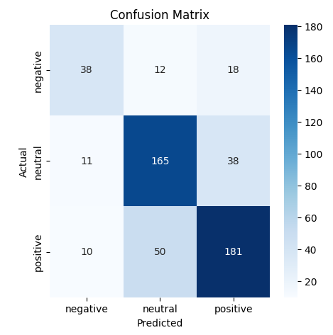
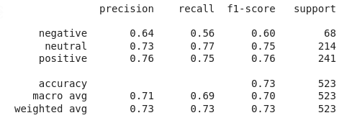
Results- Product Review Sentiment Classification

Slide 20
Results- Product Review Sentiment Classification

Slide 21
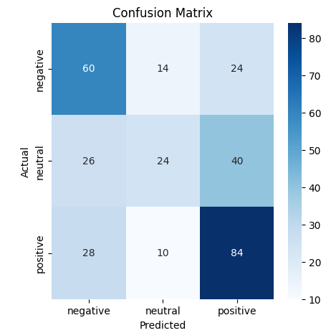
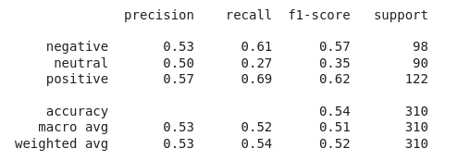
Results- Movie Review Sentiment Classification

Slide 22
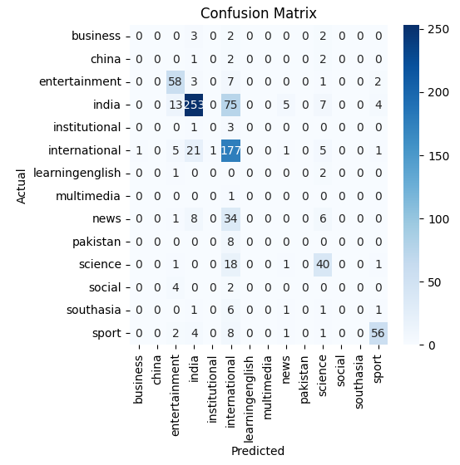
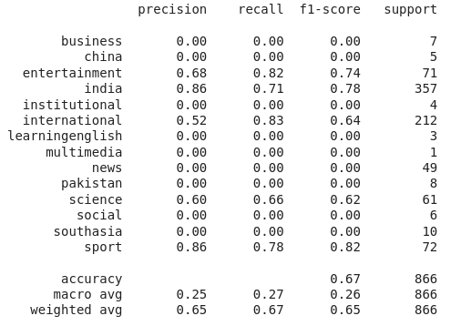
Results- BBC News Category Classification

Slide 23
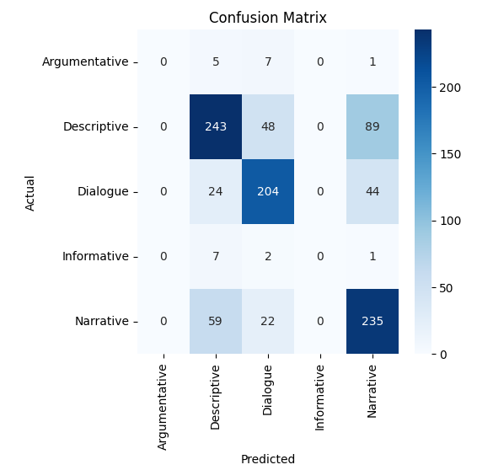
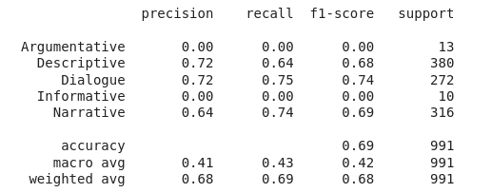
Results- MIDAS Discourse Mode Classification

Slide 24
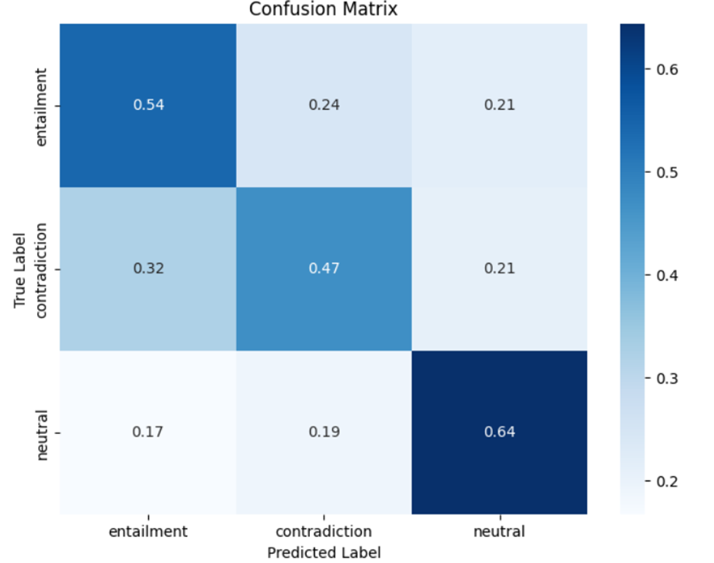
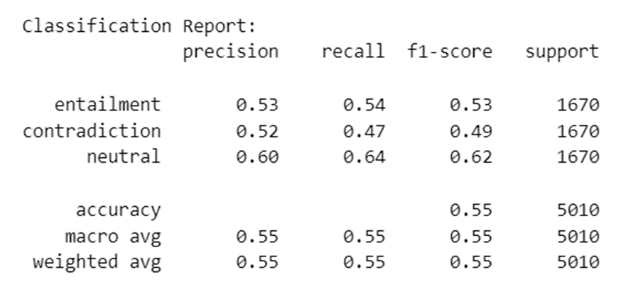
Results- NLI

Slide 25
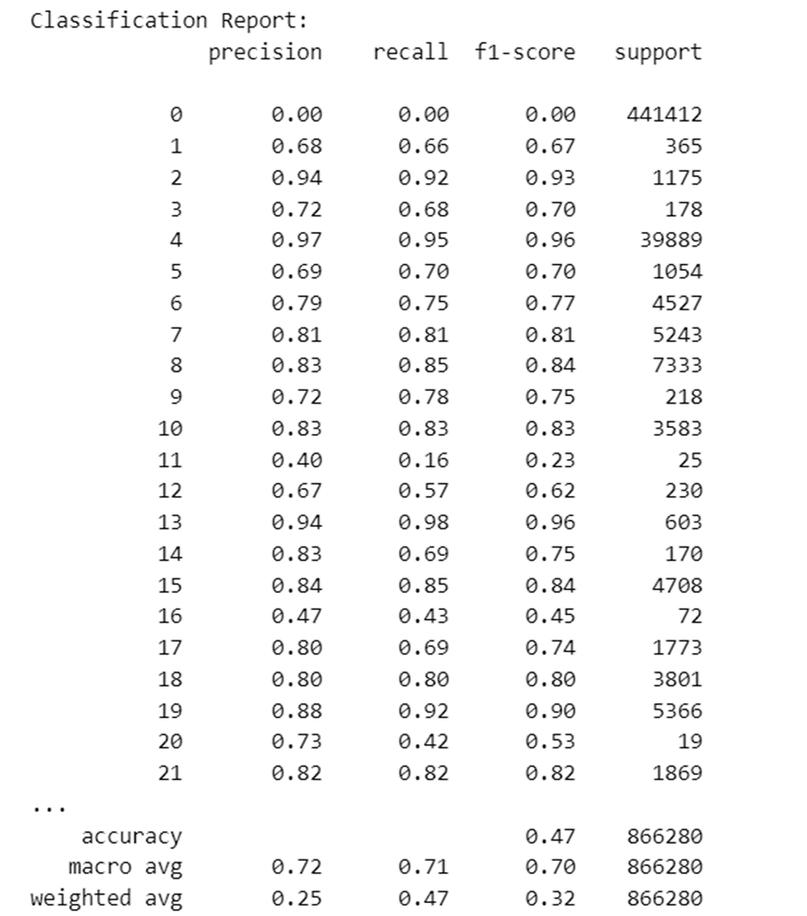
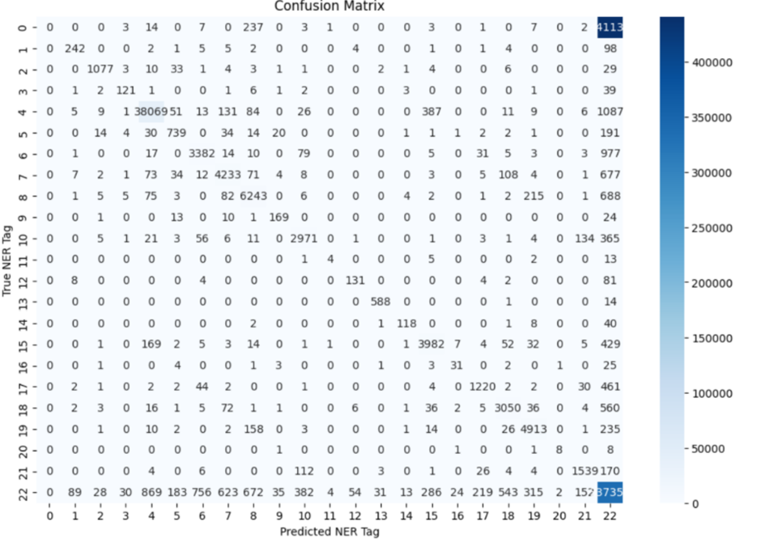
Results- NER

Slide 26
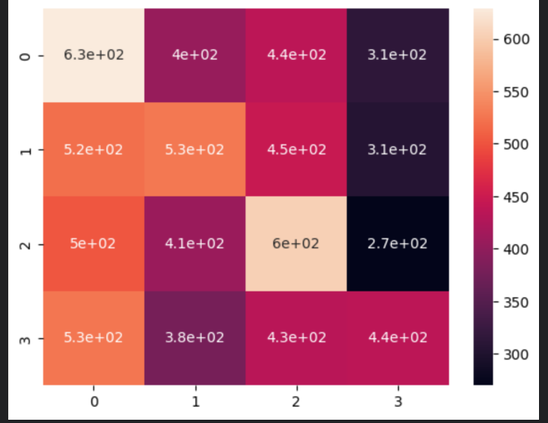
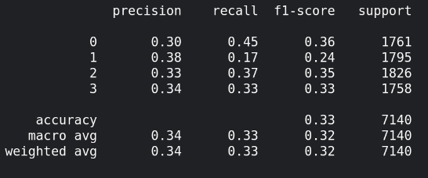
Results : Cloze Style Multiple Choice QnA

Slide 27
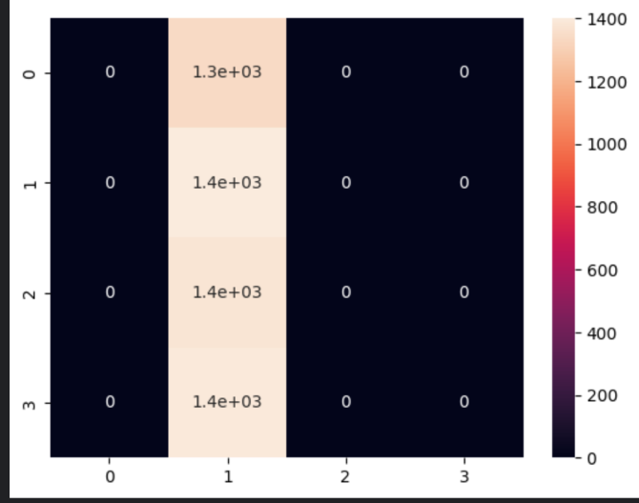
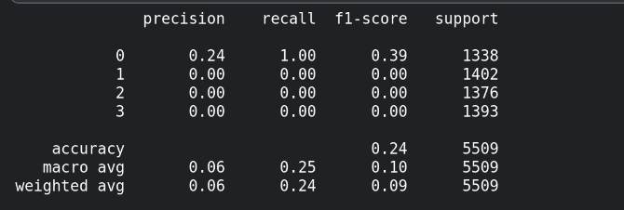
Results: Wikipedia Section Title Prediction

Slide 28
Advantages of the Proposed Metric
Ability to handle polysemy:
तुम उस पद के अधिकारी नहीं हो
Contextual embeddings will be able to figure out what context needs to be used for पद (as opposed to word similarity where पद would have been ambiguous)
तुम उस ओहदे के अधिकारी नहीं हो
Substitution is done carefully (manually), so no issues here
IndoWordnet is to be used to assist the human with synonyms

Slide 29
Advantages of the Proposed Metric
No unfair penalty for task-specific word embeddings which capture task specific word similarity:
e.g. for POS tagging task- बिल्ली and बच्ची are 'similar' because both are nouns
बिल्ली पानी पी रही है
बच्ची पानी पी रही है
Note that since the task is POS tagging, the substitution does not occur with synonym but with a word which has the same tag
बिल्ली and बच्ची both are nouns and since we are evaluating it on a downstream task (POS tagging), no unfair penalty is imposed

Slide 30
Advantages of the Proposed Metric
Ability to check robustness against word level adversarial attacks:
Useful in social media context
e.g. hate speech classification

Slide 31
Disadvantages of the Proposed Metric
There are some corner cases where the metric would fail to detect bad embeddings. E.g. when all word vectors are initialized to the same or very similar values.
Solution: Apart from the proposed metric, take into consideration the model’s performance on the downstream task using those 100 sentences. A bad word model would perform poorly, even if the proposed metric indicates presence of robust embeddings.
Computational cost is higher
Requires creation of an additional dataset which needs human resources.
Dependency on the ability of the trained model.

Slide 32
Other References
[1] Hadj Taieb, M.A., Zesch, T. & Ben Aouicha, M. A survey of semantic relatedness evaluation datasets and procedures. Artif Intell Rev 53, 4407–4448 (2020). https://doi.org/10.1007/s10462-019-09796-3
[2] Wang B, Wang A, Chen F, Wang Y, Kuo C-CJ. Evaluating word embedding models: methods and experimental results. APSIPA Transactions on Signal and Information Processing. 2019;8:e19. doi:10.1017/ATSIP.2019.12
[3] Matthew E. Peters, Mark Neumann, Mohit Iyyer, Matt Gardner, Christopher Clark, Kenton Lee, and Luke Zettlemoyer. 2018. Deep Contextualized Word Representations. In Proceedings of the 2018 Conference of the North American Chapter of the Association for Computational Linguistics: Human Language Technologies, Volume 1 (Long Papers), pages 2227–2237, New Orleans, Louisiana. Association for Computational Linguistics.
[4] Divyanshu Kakwani, Anoop Kunchukuttan, Satish Golla, Gokul N.C., Avik Bhattacharyya, Mitesh M. Khapra, and Pratyush Kumar. 2020. IndicNLPSuite: Monolingual Corpora, Evaluation Benchmarks and Pre-trained Multilingual Language Models for Indian Languages. In Findings of the Association for Computational Linguistics: EMNLP 2020, pages 4948–4961, Online. Association for Computational Linguistics.
[5] Yang, Y., Wang, X. & He, K.. (2022). Robust textual embedding against word-level adversarial attacks. Proceedings of the Thirty-Eighth Conference on Uncertainty in
Artificial Intelligence, in Proceedings of Machine Learning Research 180:2214-2224 Available from https://proceedings.mlr.press/v180/yang22c.html.

Slide 33
Thank you for your time!

